Slide 1
Funder Engagement Basics for Nonprofit Sustainability
February 20, 2020

Slide 2
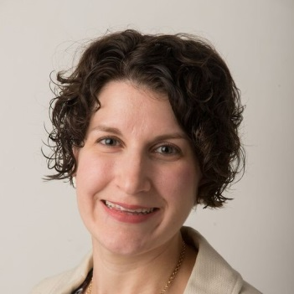
Rachel Werner
Rachel Werner is the Owner and CEO of RBW Strategy, LLC. She and her team provide customized grants and project management support and solutions to clients primarily in the Greater Washington, DC area and all over the country. She has over 16 years of grants experience and collectively, she and her team have garnered nearly $35 million and managed nearly $2 billion in grant funding. She is an active member of the Grant Professionals Association and is a Certified Grants Professional (since 2014) and a Project Management Professional (since 2010).

Slide 3
Agenda
1
What does it mean?
2
Why is it important?
Funder
Engagement Basics
3
How can I do this in my organization?
4
What are the best practices?
5
Key takeaways and Resources
Notes:
Linda - Tell Office Move Story.

Slide 4
Part I: What is funder engagement and why does it matter?

Slide 5
What is a funder engagement?
The process of building a relationship with funders from prospect through gift receipt and connecting with them in positive and meaningful ways.

Slide 6
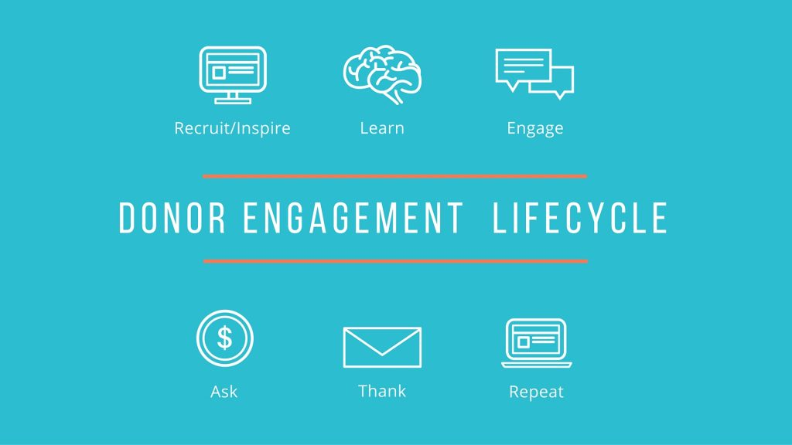
Source: https://www.causevox.com/blog/donor-engagement-cycle-inspire-learn-engage-ask-thank-show-impact/
Notes:
What do you think of this one?

Slide 7
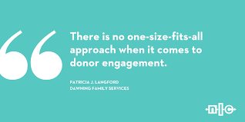
Funder Engagement
Requires:
Planning
Tracking
Review
Understanding your donors and their needs!
Notes:
What do you think of this one?

Slide 8
Different Funder Types
Major Donors and Individuals
Grant Funders
Corporate Sponsors
In-Kind
Elected Officials and Government
Social Media Sharing

Slide 9
What are Funders Looking For?
Type of funder
Why and how they like to fund organizations
The funder’s key considerations and priorities
Type of relationship you will develop with the funder

Slide 10
Funder Engagement Overview
Why
Values
Direction

Slide 11
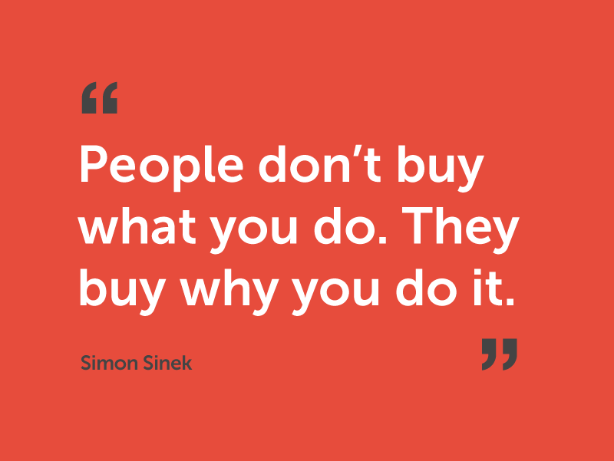

Slide 12
Values
What do you stand for?
What is your mission?
What is your vision for the future?
What will be your impact?

Slide 13
Direction
How well does your funding request map to your strategic plan?

Slide 14
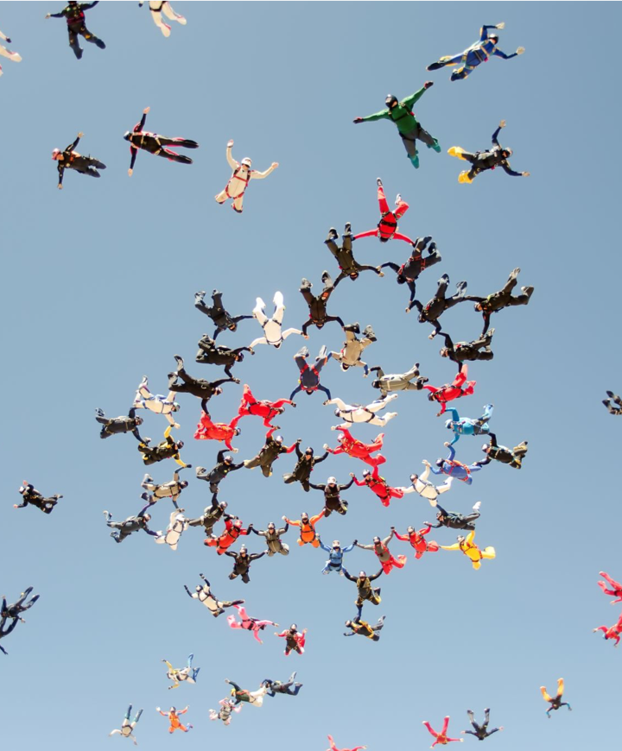
How will people want to join you if they don’t know what you stand for or your value?
Notes:
Building a pool of supporters and ambassadors

Slide 15
Why should nonprofits care?
Consistent Funding
Reputation
Following
Infrastructure and Capacity
Strategic Objectives
Notes:
-Guides people through the org’s journey

Slide 16
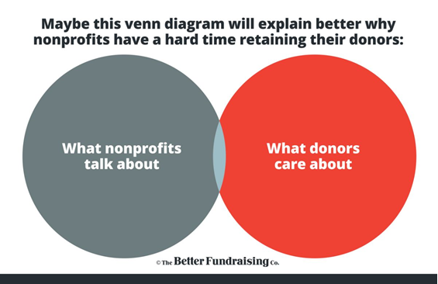
A little nonprofit humor….

Slide 17
Part II: How do we build a funder engagement strategy?

Slide 18
Internal Infrastructure
Get your house in order
Strategic Planning
Resources and Time
Systems
Data Capture
Marketing and Branding

Slide 19
Strategic Planning
Vision
Strategic Objectives
Fundraising Targets
Organizational Priorities

Slide 20
Planning: Cultivation Brainstorming
Cultivation Strategy
New or Lapsed?
Specific or general opportunity identified?
Call, email or in-person cultivation method?
Board or staff point of contact?
Pre-submission communication is an option (if grant)?
Online research available on funder?

Slide 21
Organizational Ambassadors
Public and Media
Elected Officials and Partners
Volunteers and Funders
Staff and Board

Slide 22
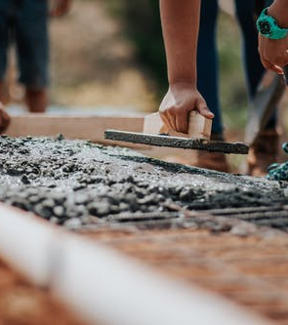
Resource Allocation
Responsibilities
Tracking
Process
Time

Slide 23
Tracking System
Reports
Institutional knowledge
Multiple users
Tracking and research
Shared spreadsheet

Slide 24
Data Capture
Success Stories
Accomplishments
Impact

Slide 25
Marketing and Branding
Does your logo speak to your brand?
Is your Web site clear and easy to navigate both for users of your service and potential donors?
Do you have an organizational brochure?
Do you have a presence on social media?
Notes:
-Guides people through the org’s journey

Slide 26
Benefits of Funder Engagement
Fundraising
Pipeline
Retention
Operations
Planning
Resource Sharing
Intrinsic
Morale
Commitment

Slide 27
Funder Engagement In Action

Slide 28
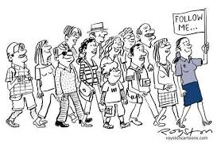
Site Visits

Slide 29
Group Volunteering

Slide 30
Progress Updates and Reports

Slide 31
Photos and Messages of Impact

Slide 32
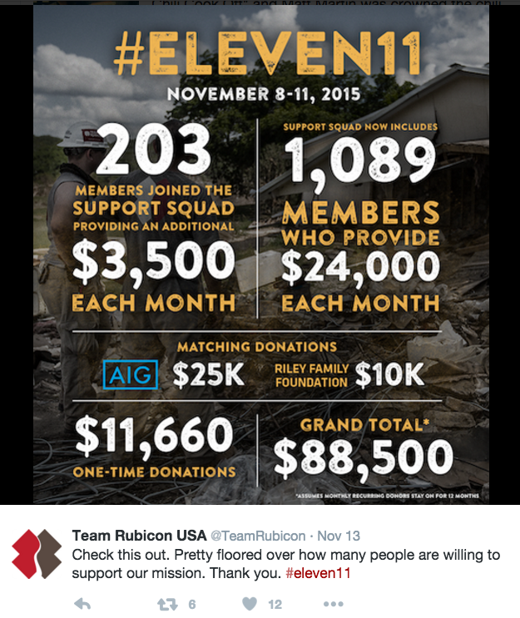
Social Media Shout Out

Slide 33
Donor Appreciation Events

Slide 34
Funder Awards
Patagonia

Slide 35
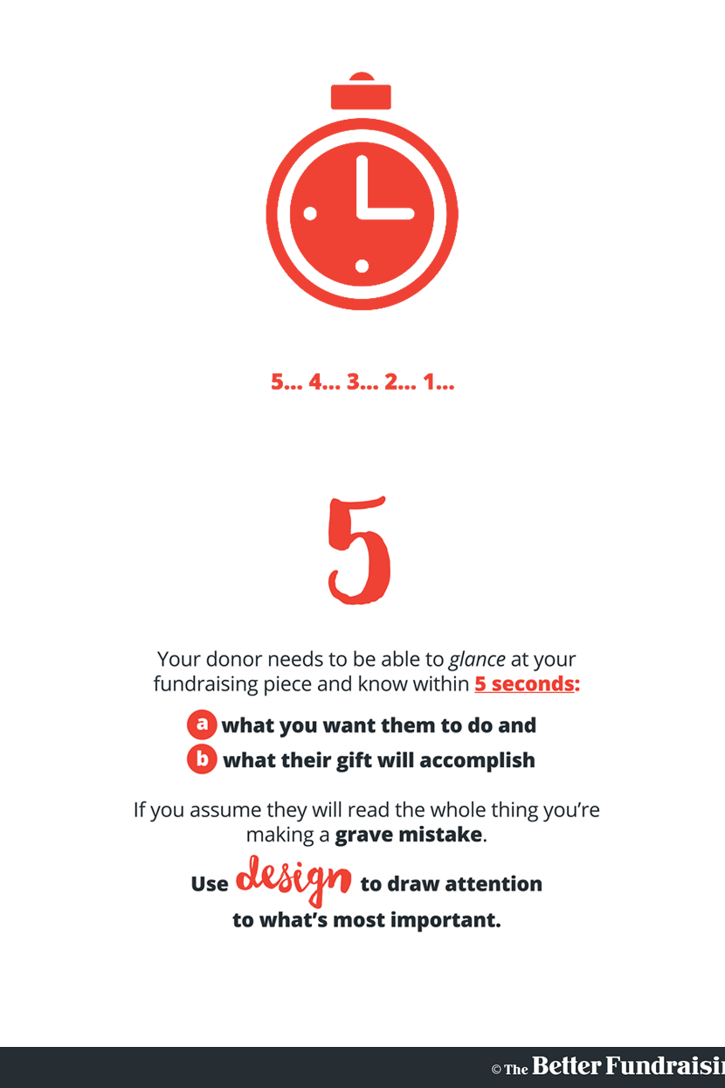
Thank You Notes
Notes:
What do you think of this one?

Slide 36
Pssst…. People Don’t Like to Read

Slide 37
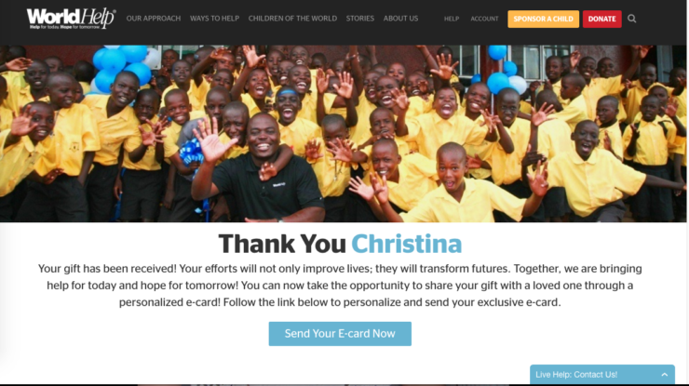
Notes:
What do you think of this one?

Slide 38
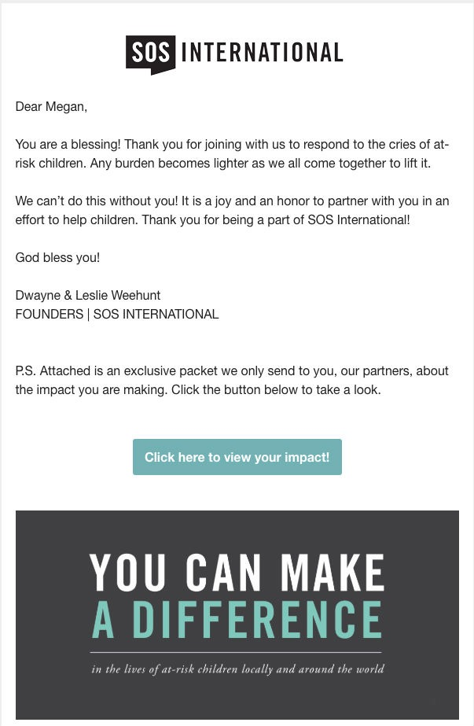
Notes:
What do you think of this one?

Slide 39
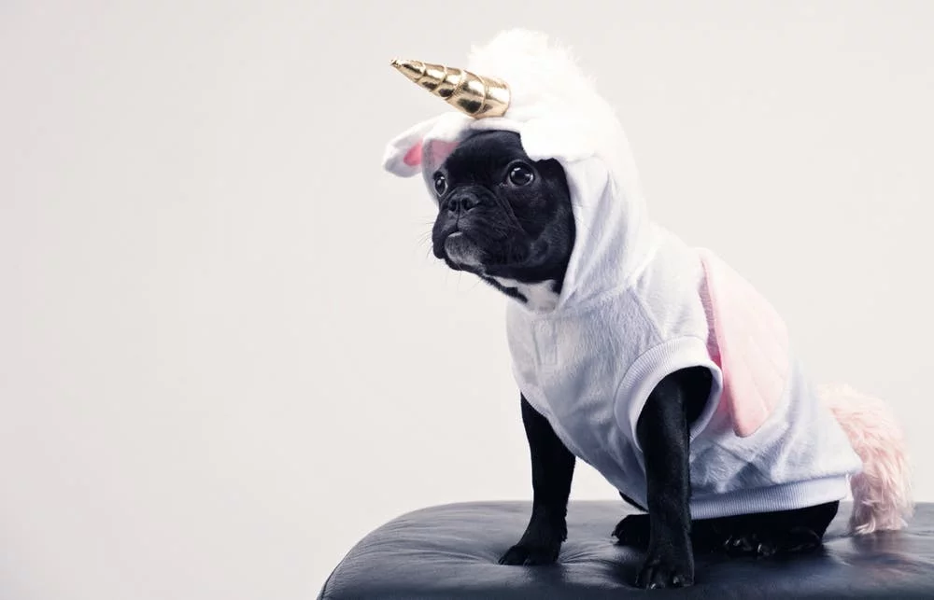
No One-Size-Fits-All Approach

Slide 40
Take Small Steps to Grow

Slide 41
Part III: How can I do this for my organization?

Slide 42
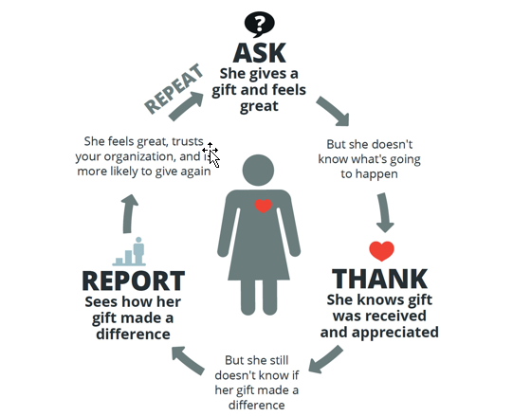

Slide 43
Step 1: Strategic Planning
Notes:
Differentiators
Strengths
Areas of growth

Slide 44
Step 2: Fundraising Goals

Slide 45
Step 3: Resource Map and Responsibilities

Slide 46
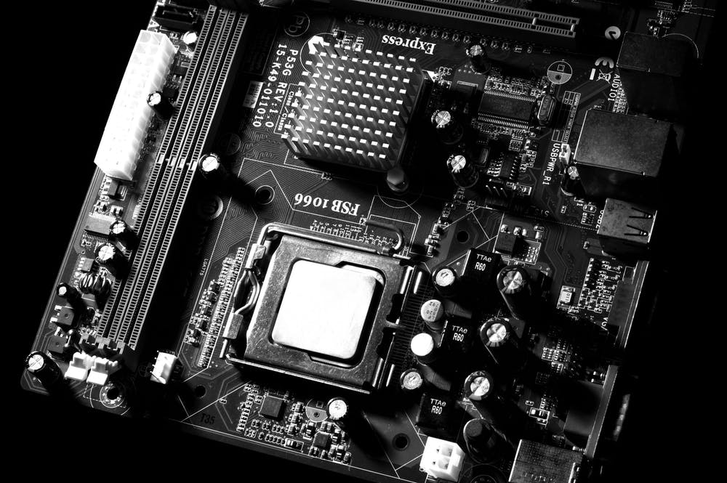
Step 4: Tracking System and Processes

Slide 47
Step 5: Targets and Metrics for all Components of the Engagement Cycle

Slide 48
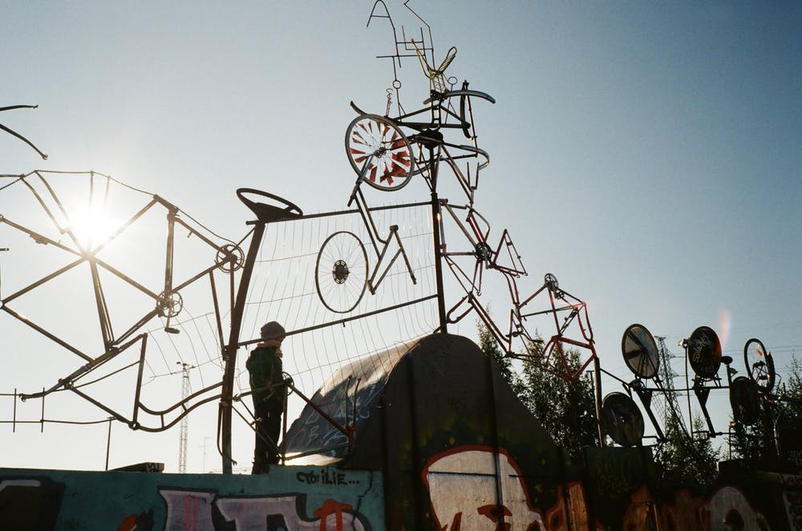
Step 6: Track and Repeat

Slide 49
Lessons Learned
Notes:
What worked this year?
Did a certain approach work better than others?
Are donors giving to a certain program? Why?
How will you modify your approach next year?
What will you do the same or differently?

Slide 50
Resources
Board Source: http://www.boardsource.org/
Gail Perry: https://www.gailperry.com/
The Better Fundraising Company: http://betterfundraising.com/
What Gives Philanthropy: https://www.whatgivesphilanthropy.com/

Slide 51
Questions?

Slide 52
Thank you!
Contact RBW Strategy if you need consulting and/or general coaching support to maintain and build your organization’s charitable investments through fundraising or project management.
RACHEL WERNER
Ph: (301) 325-8552
Email: rachel@rbwstrategy.com
LinkedIn: www.linkedin.com/in/rabwerner
Twitter: @rbwstrategy
Website: www.rbwstrategy.com

Slide 53
The content of this presentation is proprietary and RBW Strategy retains ownership of the contents herein. It is not intended to be distributed to any third party without the written consent of RBW Strategy.

