Slide 1
Student Conduct, Title IX, and Resource Training
For Student Ambassadors
September 26, 2024

Slide 2

How are you feeling today?
Could be better (use a red emoji)
I'm okay (use a yellow emoji)
I feel amazing (use a green emoji)

Slide 3
Which of these would be the hardest to live without?
Chocolate
Music
Your phone
TV / Streaming

Slide 4
Quick Leadership Lesson

Slide 5
Quote of the Week
“You cannot lead others until you first lead yourself.”
John C. Maxwell,
The Self-Aware Leader: Play to Your Strengths, Unleash Your Team

Slide 6
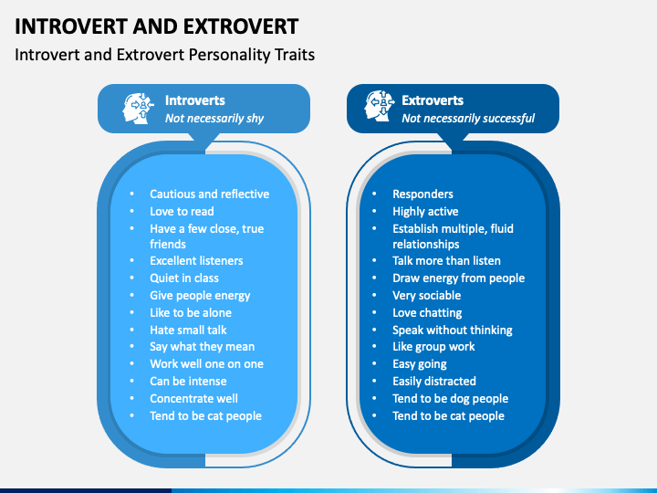
Are you an introvert, an extrovert, or an ambivert?

Slide 7
How does this help you become a better leader?
Allows you to understand your allows you to understand your strengths, weaknesses, and motivations
Can help you manage your time, energy, and relationships if you know someone else's personality type
When is the last time you did a personality test?

Slide 8
Thanks for coming to my TED Talk!

Slide 9
What CSM student resources have you used?

Slide 10
Student Life &
Support Services
Hawk Hub
Academic & Career Advising
Student Life
Athletics & Fitness
English Language Resource Team
Hawk Pantry
Financial Aid
Admissions
Counseling Services
Student Affairs, Conduct, & Title IX
Disability Support Services
Testing Center
Financial Aid
Veterans Affairs
Registrar's Office

Slide 11
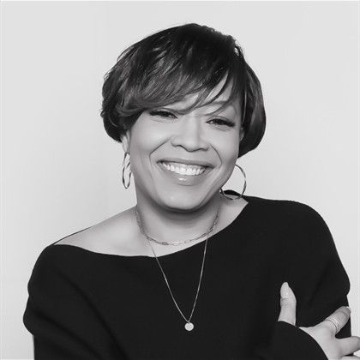
Admissions
The Admissions Department helps brand new students enroll and hosts events such as orientation, Open House, and campus Tours.
Open House – Spring 2025​
  Thursday, April 24th, 5pm-7pm – Virtual Presentation​
  Tuesday, April 29, 2025, 5-7:00pm – Prince Frederick Campus, Building PFB Rooms B103,104,105​
  Wednesday, April 30, 2025, 5-7:00pm – Leonardtown Campus, Building A, Room A206​
  Thursday, May 1, 2025, 5-7:00pm –Regional Campus, HS Building, Room 106A and 106B​
  Saturday, May 3, 2025, 12pm-2pm - La Plata Campus, BI Building, BI-113/E and other BI spaces, BI 103 & 104
Meet Jaky Tyson!
Director of Admissions

Slide 12
Title IX and Student Conduct for Student Leaders
Dr. Tracy Harris
Vice President, Student Equity and Success

Slide 13
CSM Responsibilities
To ensure that you know and are aware of the Student Code of Conduct and Title IX legislation
Educate you about what is expected of you while on campus
To ensure a safe learning environment
To provide guidance and direction when needed
To support your academic journey to make you the best that you can be

Slide 14
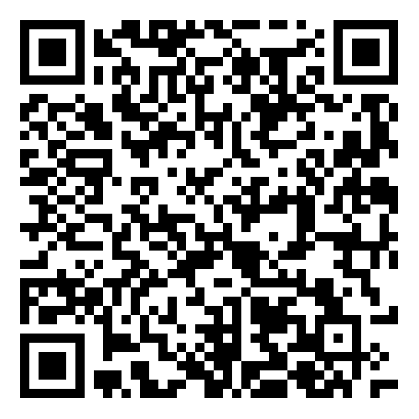
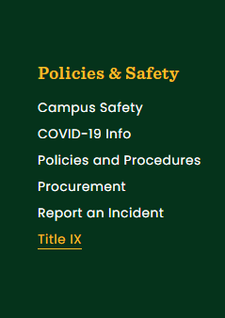
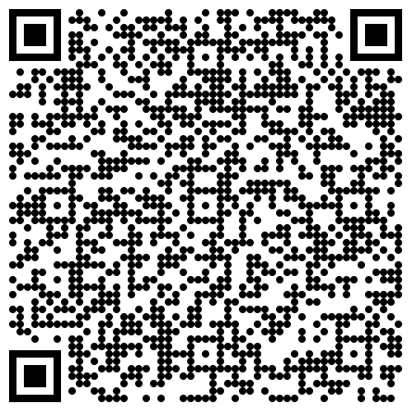
Student Code of Conduct and Title IX Legislation
Student Code of Conduct
To protect and preserve an environment conducive to educational excellence, the college has established the Student Code of Conduct and its associated processes to educate students of their academic, civic, and social responsibilities as individuals and as groups.
https://www.csmd.edu/studentaffairs
Title IX
This policy is enacted to prohibit sexual harassment, including sexual discrimination, sexual assault, domestic and dating violence, stalking, and retaliation; to establish complaint procedures to investigate allegations of violations of this policy; and to provide appropriate sanctions for violations of this policy.
https://www.csmd.edu/about/policies/policy-on-sexual-misconduct-relationships-violence-stalking-and-retaliation.html

Slide 15
Your Responsibilities and Consequences
Your Responsibilities
Consequences
Attend Classes
Engage with faculty and staff
If you see something, say something
Report concerning behavior
Know your rights as a CSM student
Be an active Student Ambassador
Failing grades in courses
Disciplinary action (Student Code of Conduct)
Student Conduct Hearing
Suspension
Expulsion

Slide 16
Unacceptable behavior on a CSM campus:
Disruptive behavior in or out of the classroom
Threatening Behavior in or out of the classroom
Any form of harassment to students or other individuals
Disrespectful conversation that does not support a positive learning environment
Academic Dishonesty (cheating, plagiarism, etc.)
Intentionally missing or skipping out of class
Not actively participating in college assignments and work

Slide 17
While you are on a CSM Campus you should:
Value the experience and respect the learning environment
Take advantage of faculty, staff, and resources around you
If time permits, take advantage of college resources (tutoring, mentoring, PE, etc.)
Know your Resource people!
  Destini Courtney, AD 207, drcourtney@csmd.edu
  Dr. Harris, AD 207, taharris1@csmd.edu

Slide 18
Mandatory Events This Semester
5 Oct.
Amplify Student Voices
14 Oct.
Fall Fest – Week of October 14
Tue. – 3 Dec.
Giving Tuesday – December 3-4

Slide 19

Questions

Slide 20
Leadership tip to apply report back at next check in

Slide 21
Next Meeting
Good leaders who are self-aware don’t just help themselves. They help the people on their team to find their strengths, and they empower them to work in those strengths.”
What are your strengths and weaknesses
Personality test
Thomas V. Mike Miller, Jr. Center for Leadership

