Slide 1


WELCOME
CONNECTING
AND CONVENING
Making an Impact Together
SCAN FOR
ONLINE PROGRAM

Slide 2
STEPPING BACK TO MOVE FORWARD: HISTORICAL CONTEXT
Truman Commission (1947) established network of
public 2-year institutions
Fully integrated into and meeting the needs of the communities they serve
Broad portfolio of academic programs (transfer, vocational/workforce,
adult education)
Closely aligned with high schools for seamless transfer
Affordable and accessible
Double college-going rate and close equity gaps
  Race/ethnicity,
  gender, religion, and socio-economic status
CONNECTING AND CONVENING

Slide 3
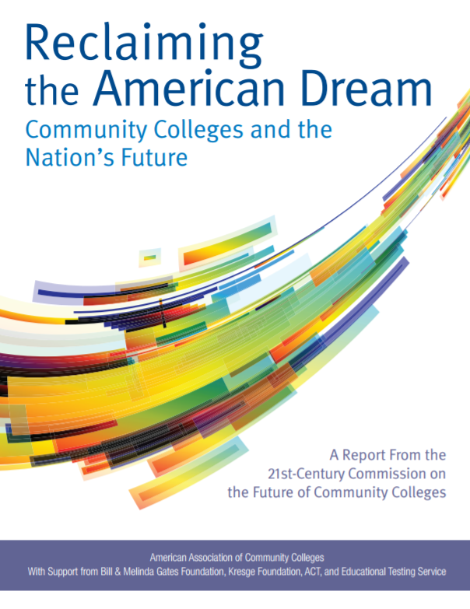
RECLAIMING THE AMERICAN DREAM
COMMUNITY COLLEGES AND THE NATION’S FUTURE
CONNECTING AND CONVENING

Slide 4
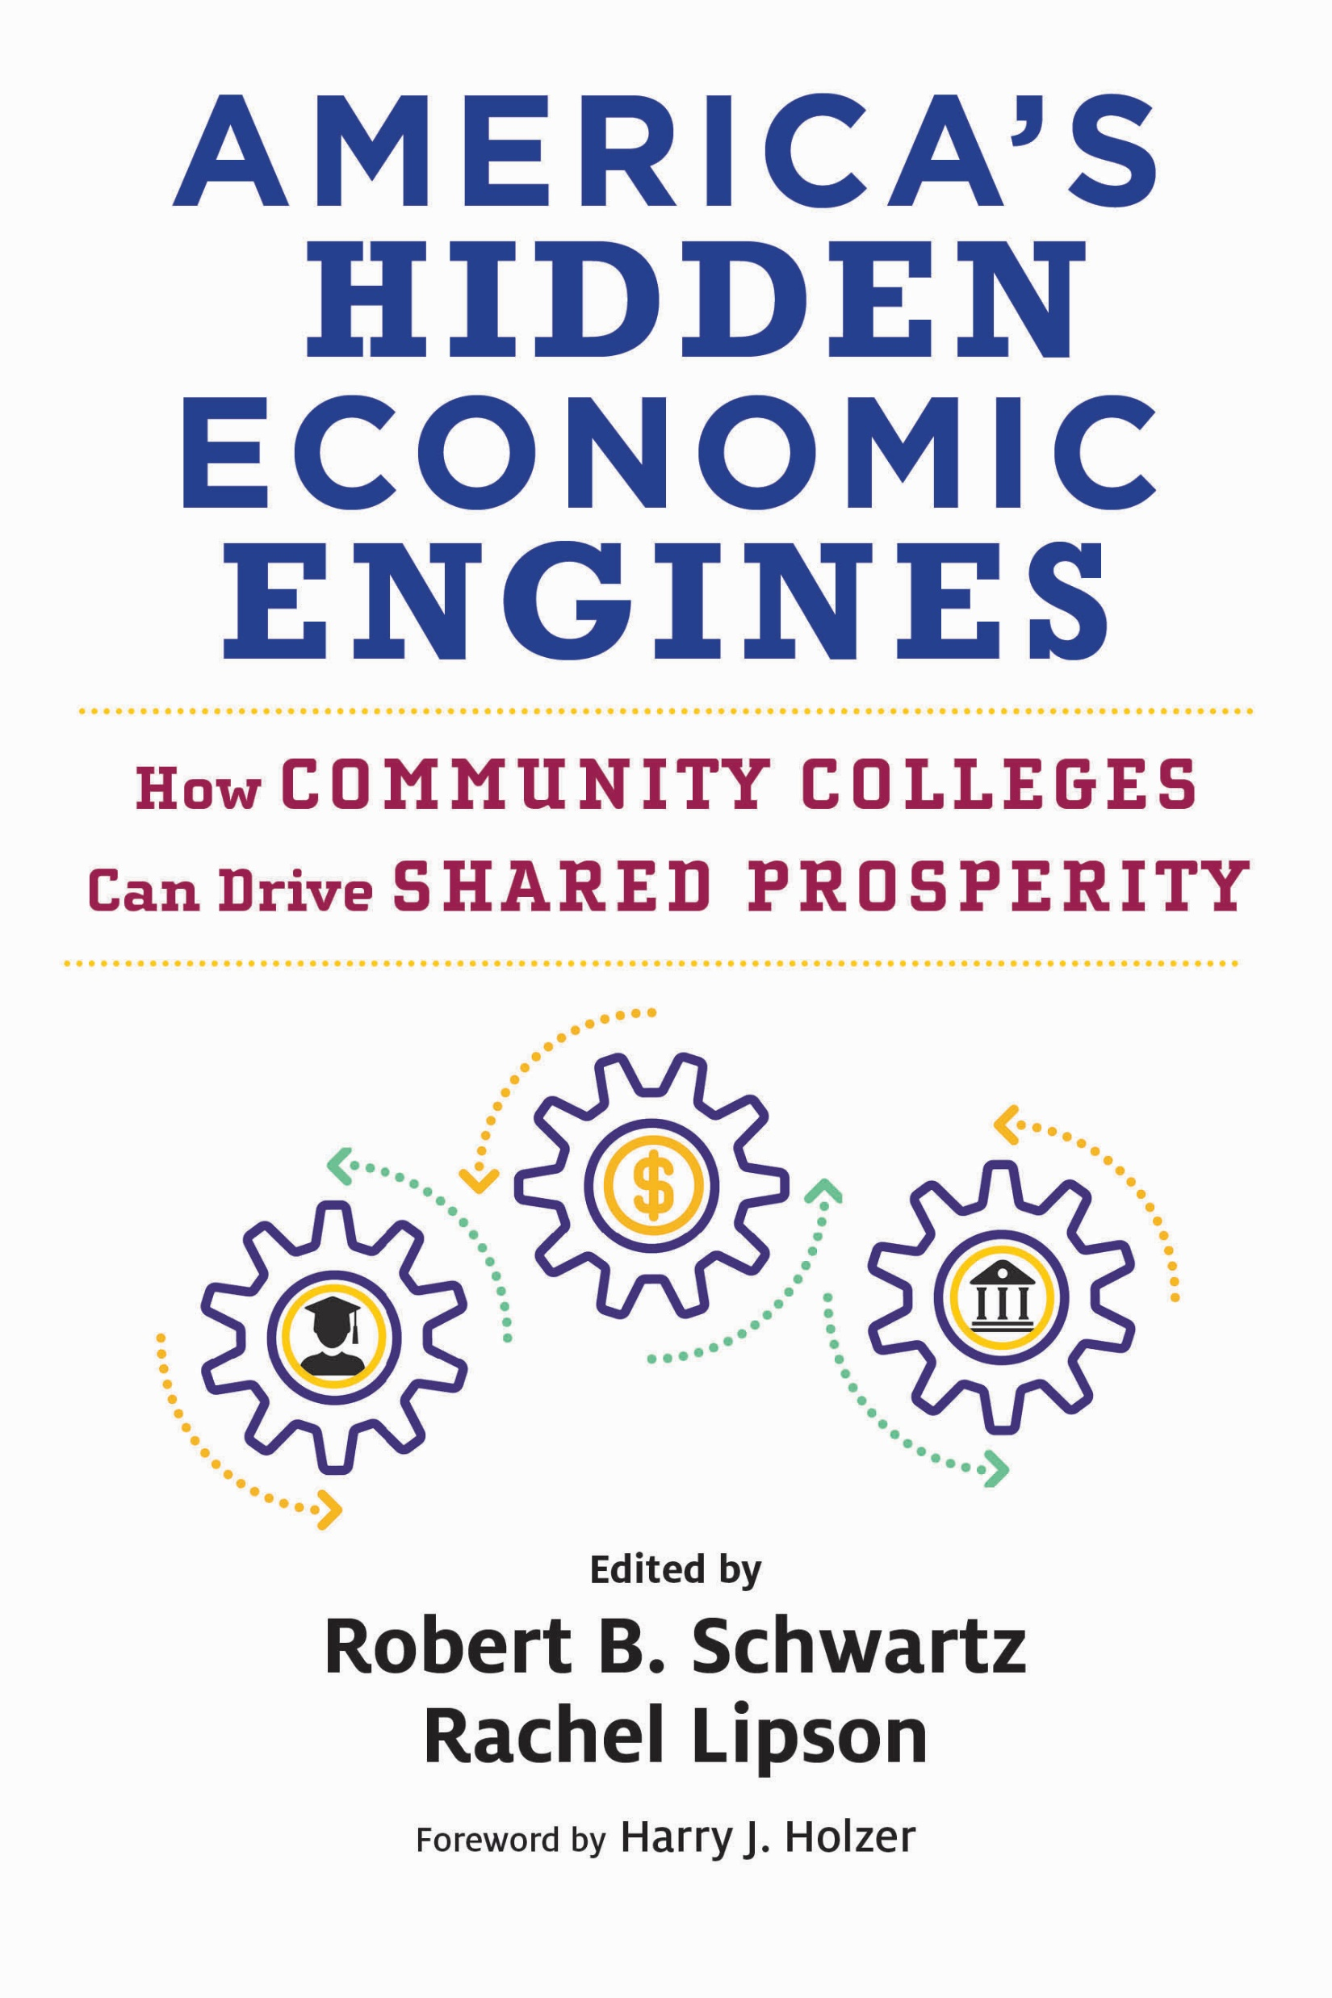
AMERICA’S
HIDDEN ECONOMIC ENGINES:
HOW COMMUNITY COLLEGES
CAN DRIVE SHARED PROSPERITY
CONNECTING AND CONVENING

Slide 5
Community Colleges
Employers
Community-Based Organizations
4-Year Institutions
K-12
Local and State Government
Economic Development Agencies
THE FUTURE COMMUNITY COLLEGES AS HUBS
OF LEARNING, CREDENTIALING, AND MOBILITY FOR ALL STUDENTS
CONNECTING AND CONVENING

Slide 6
TOGETHER, WE CAN!
CONNECTING AND CONVENING

